Slide 1
Relations
Jorge Cobb
The University of Texas at Dallas

Slide 2
What are relations?
Relations are a formal means to specify which elements from two or more sets are related to each other
Examples
  {students} who take {courses}
  {businesses} and their {telephone numbers}
  {integers} and their {divisors}
  {program variables} and the {subroutines} they are used in

Slide 3
Definition of relations
Let A and B be two sets. A binary relation R from A to B is a subset of A × B.
  Note that the order of the two sets matters.
More generally, let A₁, A₂, ..., A_{n} be n sets. An n-ary relation R on these sets is a subset of A₁ × A₂ × ... × A_{n}.
  The sets A_{i} are known as the domains of the relation, and n as its degree
  Again, the order of the domains matters.

Slide 4
Example
Let A = {0,1,2} and B = {a,b,c}.
Then, R = {(0,a), (1,a), (1,b)} is a relation from A to B.
For instance,
  (0,a) in R, but (a,0) is not in R (order matters!)
  Note that no element in A is related to c (which is fine), and 2 is not related to any element in B.
(0,a) in R is also denoted 0 R a

Slide 5
Functions
A function f : A → B is a special case of a relation from A to B
  It satisfies the property: for each x ∈ A, there is exactly one pair (x, f(x)) in the relation
Relations are more general than functions
  They allow unmapped elements from A
  They allow one-to-many mappings where an element from A maps to multiple elements from B
  They also allow many-to-one and many-to-many mappings
  I.e., any subset of A x B is a relation.

Slide 6
Relations on a set
A relation R on a set A is a relation from A to A, that is, a subset of A × A, i.e. of, A²
Examples (on the set of integers):
  x is equal to y
  x is greater than y
  x divides y
Note that in these cases both A and the relation R are infinite sets

Slide 7
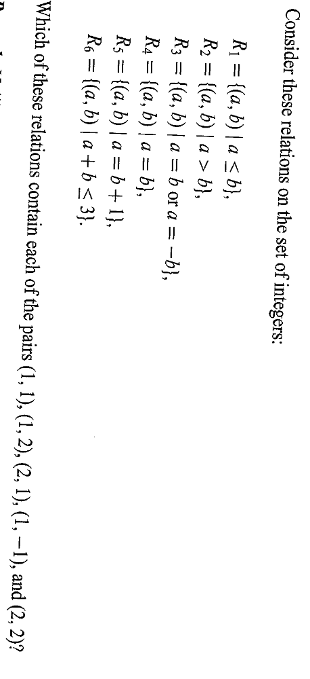
Example

Slide 8
How many relations are there?
Relations on a set A with n elements
A² has n² elements. We know that the number of subsets of a set with m elements is 2^{m}, so the desired number is 2^{n2}.
The number of functions from A to A is
Is this asymptotically the same?
n^{n} = (2^{logn})^{n} = 2^{nlogn} which grows slower than 2^{n2}.
n^{n}

Slide 9
Properties of relations
A relation R on a set A is
reflexive, if
  ∀x ∈ A, (x, x) ∈ R
symmetric, if
  ∀x∀y, (x, y) ∈ R ⇒ (y, x) ∈ R
antisymmetric, if
  ∀x∀y, (x, y) ∈ R and (y, x) ∈ R ⇒ x = y
transitive, if
  ∀x∀y∀z, (x, y)∈R and (y, z) ∈ R ⇒ (x, z) ∈ R

Slide 10
What properties are satisfied by the relation R = {}?

Slide 11
Example
Consider the “divides” relation on the set of nonnegative integers: x|y iff x divides y.
Reflexive?
  NO. 0 does not divide 0. (would be reflexive on the set of positive integers, though)
Symmetric?
  NO. 2 divides 4, but not the other way around.
Antisymmetric?
Transitive?
YES
YES

Slide 12
Example
Which of the above relations are reflexive, symmetric, anti-symmetric and transitive?

Slide 13
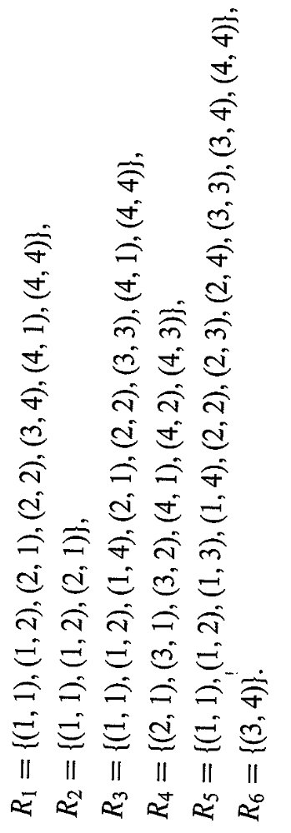
Example
Which of the above relations are reflexive, symmetric, anti-symmetric and transitive?

Slide 14
Counting the reflexive relations
How many reflexive relations are there on a set A with n elements?
Consider the pairs B:{(x, x) with x ∈ A}.
  There are n such pairs, they must occur in the relation.
  For every pair (x, y) with x ≠ y, (there are n(n-1) of them) it may occur in the relation or it may not
  Thus, there are 2^{n(n-1)} total reflexive relations.

Slide 15
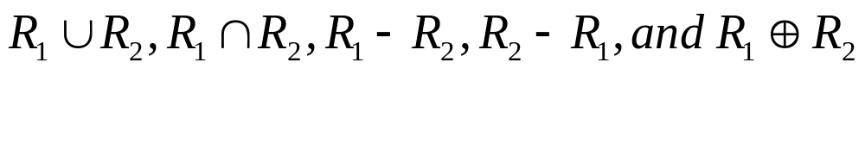
Combining relations
Since relations are by definition sets, they can be combined in any way that sets can be combined, including union, intersection, and set difference.
Let R₁ = {(x,y) | x < y}
R₂ = {(x,y) | x > y}
What is

Slide 16

Closure
A closure of a relation is the smallest superset of the relation that contains the desired property.
E.g., the reflexive closure of a binary relation R on a set X is the smallest reflexive relation on X that contains R.

Slide 17
Closure example
Give the symmetric closure of the reflexive closure of the transitive closure of
R = {(2,1),(2,3)}
Transitive closure :
  {(2,1),(2,3)}
Reflexive closure :
  {(1,1),(2,1),(2,2),(2,3),(3,3)}
Symmetric closure:
  {(1,1),(1,2),(2,1),(2,2),(2,3),(3,2),(3,3)}

Slide 18
More on closures
Does every relation have a transitive closure?
  Yes (more on that later)
Does every relation have a reflexive closure?
  Yes, we saw the formula a few slides ago
Does every relation have a symmetric closure?
  Yes, for every pair (a,b) in R add the pair (b,a)
Does every relation have an anti-symmetric closure?
  No. In a closure you can only add edges, not take them away. A relation R has an anti-symmetric closure only if R is anti-symmetric to begin with. (The closure is R itself)

Slide 19
Composition of relations
The composition of two relations R: A→B and S: B→C, denoted S○R, is the relation from A to C containing all pairs (x, z) such that there is one y ∈ B with (x, y) ∈ R and (y, z) ∈ S.

Slide 20
Example
What is the composite S○R, where
  R = {(1,1),(1,4),(2,3),(3,1),(3,4)}
  S = {(1,0),(2,0),(3,1),(3,2),(4,1)}

Slide 21
Composing the parent relation
Let R be the relation on the set of all people such that a R b if a is the parent of b.
If (a,c) in R○R, what is the family relationship between a and c?
If (a,d) in R○R○R, what is the family relationship between a and d?

Slide 22
Powers of relations
The nth power of a relation R for n ≥ 1 is defined recursively as
  R¹ = R
  R^{n+1} = R^{n} ○ R
Again, let R be the parent relation
Let (a,x) in R^{n}, what is the relationship between a and x?

Slide 23
Transitivity and Powers
Theorem: A relation R is transitive if and only if R^{n} ⊆ R for all n, n >= 1
Proof
  We first show that if R^{n} ⊆ R for all n then R is transitive
  Simple, we must show that if (a,b) and (b,c) are in R then (a,c) is also in R.
  Note that if (a,b) and (b,c) are in R then (a,c) is in R², and R² ⊆ R from our assumption, so we are done.
  Continues …

Slide 24
Transitivity and Powers contd..
We next show that if R is transitive then R^{n} ⊆ R for all n. We show it by induction on n.
Base, n = 1, trivial, R¹ = R ⊆ R
Assume for all i, i ≤ n, R^{n} ⊆ R, show that
R^{n+1} ⊆ R
  Let (a,c) be any pair in R^{n+1}, we must show it is in R
  Thus, from composition, there is an element b such that (a,b) is in R and (b,c) is in R^{n}
  From ind. hyp., (b,c) is in R (we assumed R^{n} ⊆ R) and from the previous bullet (a,b) is in R, and since R is assumed transitive, then (a,c) is also in R, and we are done.

Slide 25
Transitive Closure
Let R be any relation (transitive or not)
Let R* be the union of all the powers of R.
I.e., R* = U_{n} R^{n}
Is R* the transitive closure of R?
  Hmmm, maybe, we shall see.
E.g., let R be the parent relation
Let (a,x) in R*, what is the relationship between a and x?

Slide 26
Transitive Closures and transitivity
Corollary: A relation R is transitive iff R = R*.
remember that R* = U_{n} R^{n}
From the theorem,
  R* ⊆ R iff R is transitive,
and we know that
  R* ⊆ R iff R = R*
The second bullet above is because R* by definition is a superset of R, so to be a subset it must be equal to R.

Slide 27
Transitive Closure
Is R* is the transitive closure of R?
  Can you prove it?.
  You have to show that R* is transitive.
  And that every new pair (a,b) introduced that is not in R is necessary to make R transitive.
  In general, what is R^{i}? hmmm

